Slide 1

Interim Corporate Specification Committee Meeting
09/07/2026
Highlights of 2023-24
&
Status of AWP projects of 2024-25
Corporate Chemistry

Slide 2
Proposed Modification in Existing Specification and
Standard Test Procedure of Drilling Fluid Chemicals
Modification in Specification of Clay Free Non-Damaging Drilling Fluid System (Offshore Areas) (ONGC / DFC / 95 / 2026)
Modification in Specification of Clay Free NDDF System (Onshore Areas) (ONGC / DFC / 103 / 2026)
Modification in Specification and Standard Test Procedure of Non-Invasive Fluid (ONGC / DFC / 84 / 2026)
Modification in Specification and Standard Test Procedure of Soda Ash (ONGC / DFC / 60 / 2026)

Slide 3
Proposed Modification in Existing Specification and
Standard Test Procedure of Drilling Fluid Chemicals
Modification in Standard Test Procedure of LTSOBM (ONGC / DFC / 86-89 / 2026) & WBM (ONGC / DFC / 90-104 / 2026)
Modification in Specification of LTSOBM (ONGC / DFC / 86-89 / 2026)
Inclusion of General Instruction for Pressurisation of Aging Cell
Conversion of Tentative Specification of Flat Rheology SOBM (350oF) to Corporate Specification

Slide 4
Modification in Specification of Clay Free NDDF System
(Offshore & Onshore Areas) (ONGC / DFC / 95 & 103 / 2026)
S. N. | Parameter | Existing Specification | Proposed Specification | Reason/ Justification
7. | pH at 75±4°F (BHR) | 8.5-9.0 | 9.5-10 | Pre Gelatinised Starch tends to get degraded at lower pH.

Slide 5
Modification in Specification & Standard Test Procedure of Non-Invasive Fluid (ONGC / DFC / 84 / 2026)
S. N. | Parameter | Existing Procedure | Suggestions
4. | Screening test/sieve analysis | Dry the Non –Invasive Fluid (NIF) additive samples into Hot air Oven at 70°C for 3 hrs. 10 gm. of sample from above is to be taken over the perfectly cleaned and dry (there should be no clogging of sieve) 100 mesh ASTM sieve. Fix this sieve over the sieve container with proper gasket fitting. Put the above set-up into sieve shaker. Manually set the time and vibration rate on sieve shaker console (3000 vibrations/ minute for 10 minutes). Top cover fixture opening should be covered to avoid the loss of material due to vibration. Start the equipment and record the value as specification. | The existing sieve shaker in labs do not have any option to set the vibration. The committee is requested to decide on the changes.

Slide 6
Modification in Specification & Standard Test Procedure of Non-Invasive Fluid (ONGC / DFC / 84 / 2026)
S. N. | Parameter | Existing Procedure | Proposed Procedure | Reason/ Justification
6.D.c | Invasion Test | The invasion test for the base mud and NIF additive treated base mud after hot rolling (100°C, 16 hrs.) is to be carried out with new NIF evaluation apparatus (available in IDT Lab) on, a dry sand bed of 11cm from bottom end with uniform compaction. This sand bed is prepared by using the cleaned & 140 dry frac. sand (20/40)… (cont.) | The invasion test for the base mud and NIF additive treated base mud after hot rolling (100°C, 16 hrs.) is to be carried out with new NIF evaluation apparatus on, a dry sand bed of 11cm from bottom end with uniform compaction. This sand bed is prepared by using the cleaned & 140 dry frac. sand (20/40)… (cont.) | Facility is also available with other RGLs.
6. | Performance Test | Temperature is not specified in the existing procedure. | All rheological parameters to be tested at 24 ±2 oC | As the rheological parameters in performance test are usually measured at 24±2 oC for OFCs.

Slide 7
Modification in Standard Test Procedure of Soda Ash
(ONGC / DFC / 60 / 2026)
S. N. | Parameter | Existing Procedure | Proposed Procedure | Reason/ Justification
4. | Determination of purity as Na2CO3 | Weigh accurately about 1.0 gm of dry soda ash. Transfer it completely to a 500 ml. conical flask and dissolve it in 100 ml. of distilled water. Add 4 drops of methyl orange indicator solution and titrate with standard sulphuric acid (1N) to a distinct red colour. | Weigh accurately about 1.0 gm of dry soda ash as obtained after determination of Volatile Matter in Sl. No. 3. Transfer it completely to a 500 ml. conical flask and dissolve it in 100 ml. of distilled water. Add 4 drops of methyl orange indicator solution and titrate with standard sulphuric acid (1N) to a distinct red colour. | For Clarity and uniformity in the specification and procedure.

Slide 8
Modification in Standard Test Procedure of LTSOBM (ONGC / DFC / 86-89 / 2026) & WBM (ONGC / DFC / 90-104 / 2026)
S. N. | Parameter | Existing Procedure | Proposed Procedure | Reason/ Justification
4.7/ 4.8 | HTHP Filtration Loss | Arrange the HTHP cell assembly and ensure that the O-ring to be used are in good condition. Preheat the jacket about 100F above the required temperature (or as per ONGC‘s scope of work) Mix mud with HBM at high speed (22000 rpm) for 5 minutes before pouring in HTHP cell. Fill about 2/3rd of the cell with the fluid to be tested. Place a special hardened 2.5” (6.3 cm.) diameter filter paper followed by screen. Fix the cell in the jacket and apply a pressure of 300 psi at the top. A back pressure of 100 psi can be applied and kept till the designated temperature is attained. | Arrange the HTHP cell assembly and ensure that the O-ring to be used are in good condition. Preheat the jacket about 100F above the required temperature (or as per ONGC‘s scope of work) Mix mud with HBM at high speed (22000 rpm) for 5 minutes before pouring in HTHP cell. Pour the fluid sample into the filter cell, leaving at least a 2.5 cm (1 in.) space in the cell to allow for fluid expansion. Place a special hardened 2.5” (6.3 cm.) diameter filter paper followed by screen. Fix the cell in the jacket and apply a pressure of 100 psi at the top and kept till the designated temperature is attained. | Adopted from API 13 B1 & B2.

Slide 9
Modification in Standard Test Procedure of LTSOBM (ONGC / DFC / 86-89 / 2026) & WBM (ONGC / DFC / 90-104 / 2026)
S. N. | Parameter | Existing Procedure | Proposed Procedure | Reason/ Justification
4.7/ 4.8 | HTHP Filtration Loss | As soon as the test temperature is reached, increase the pressure at the top valve to 600 psi to get a differential pressure of 500 psi across the cell. | As soon as the test temperature is reached, apply the 100 psi back pressure and increase the pressure at the top valve to 600 psi to get a differential pressure of 500 psi across the cell. | Adopted from API 13 B1 & B2.

Slide 10
Modification in Specification of LTSOBM
(ONGC / DFC / 86-89 / 2026)
S. N. | Existing Parameter | Proposed Parameter | Reason/ Justification
9. | Emulsion Stability at 120±5°F, volts: 550 (Minimum) | Emulsion Stability at 120±4°F, volts: 550 (Minimum) | Typographical error

Slide 11
Inclusion of General Instruction for Pressurization of
Aging Cell
Desired Aging Temperature |  | Applied Initial Pressure
oF | oC | psi
212 | 100 | 25
250 | 121 | 50
300 | 149 | 100
350 | 177 | 150
400 | 204 | 200 (FANN) / 250 (OFITE)

Slide 12
Other Agenda- Conversion of Tentative Specification to
Corporate Specification
LTSOBM FORMULATION FOR FLAT RHEOLOGY (350oF)
Rheological parameters measured at | 120±4°F after hot rolling at 350±4°F for 16 hrs
Mud Weight at 75±4°F (BHR), ppg | 10.0 ± 0.1
Plastic Viscosity at 120°±4°F, cP | 45 (Maximum)
Yield Point at 120°±4°F, lbs /100 sq.ft | 15 - 35
Yield Point at 39°±4°F, lbs /100 sq.ft | Increase should not be more than 15% of Sl. No. (3)
Gel0 at 120°±4°F, lbs /100 sq.ft | 8 - 18
Gel10 at 120°±4°F, lbs /100 sq.ft | 12 - 30
Gel10 at 39°±4°F, lbs /100 sq.ft | Increase should not be more than 15% of Sl. No. (6)
rpm LSRV at 120°±4°F, Dial reading | 8 - 16
O:W ratio | 75:25
WPS (Cl-), g/l | 170 - 190
Emulsion Stability at 120±4°F, volts | 550 (Minimum)
HPHT Filtration Loss (30 mins at 300°F/ 500 psi as per API, all oil), ml | 5.0 (Maximum)

Slide 13
Other Agenda- Repository for Tentative Specification
A centralised repository of approved Tentative Specifications
along with Material Code,
Test Procedures,
Testing Charges
for information to all the stakeholders.

Slide 14



Go Green
Go Paperless

Slide 15
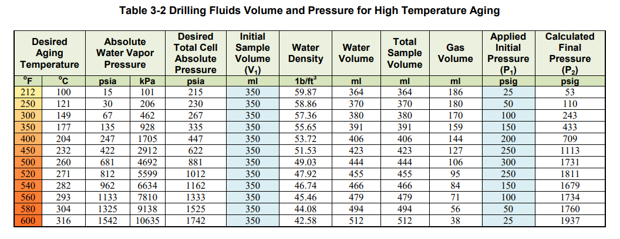
FANN

Slide 16
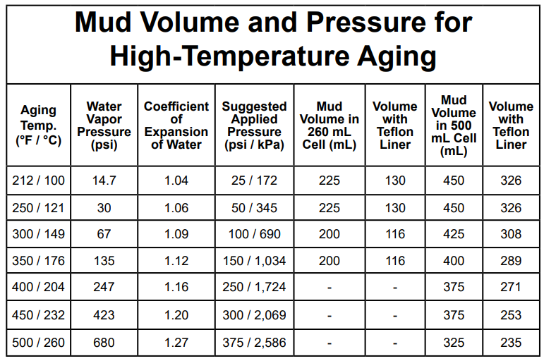
OFITE

Slide 17
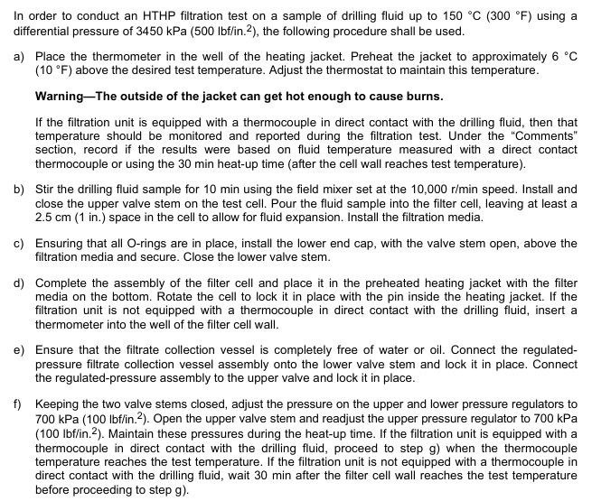
API 13B-1 & 13B-2

Slide 18
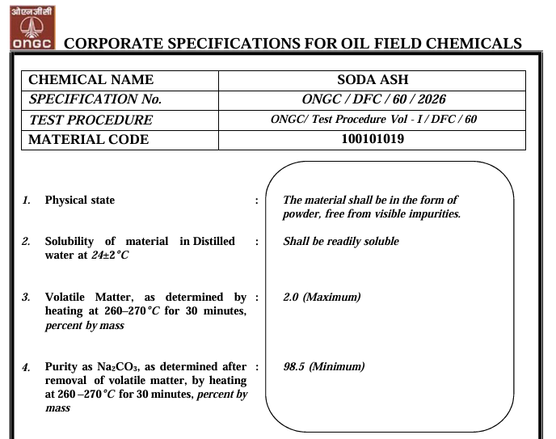
Soda Ash Specification

Slide 19
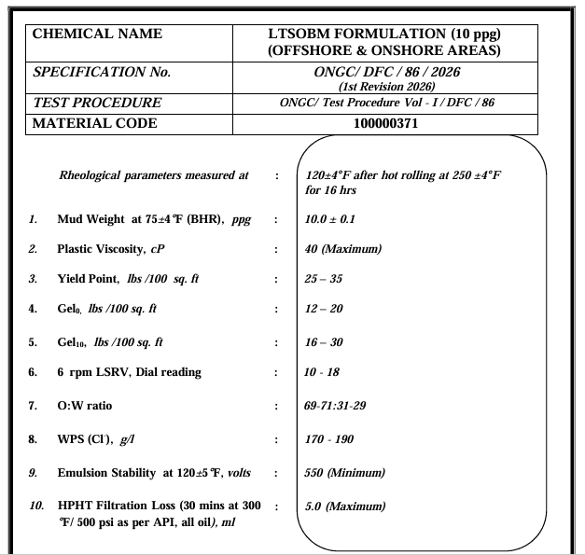
LTSOBM Specification

